Slide 1
Predicting Insurance Claim Costs: A Data-Driven Approach for Premium Development
GROUP 2:
LAXMAN SUDHAN - 50714
RAM RIDHAN - 49775
MUFANG YANG - 40658
YASH MISHRA - 44369
PENG XIANG - 47743

Slide 2
OBJECTIVE
Analyse claim frequency and severity using machine learning to develop accurate cost estimates and quantify uncertainty.

Slide 3
ABOUT DATASET

Slide 4
Data preparation and Cleaning
The merged dataset has 10 columns with 330535 obsearvations. The target variable to be predicted is PurePremium.
Risk factors: (e.g: DriverAge, CarAge, Power)
Categorical attributes: (e.g: Region, Brand, Gas)
Removed column: (Unnamed: 0, Exposure)

Slide 5
Exploratory Data Analysis

Slide 6
Exploratory Analysis Overview
Data preparation and cleaning
Univariate Data Analysis
Bivariate Data Analysis

Slide 7
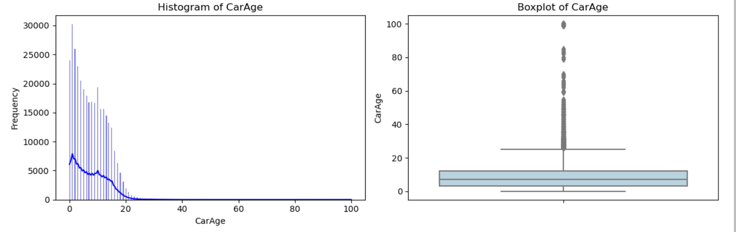
Univariate Analysis

Slide 8
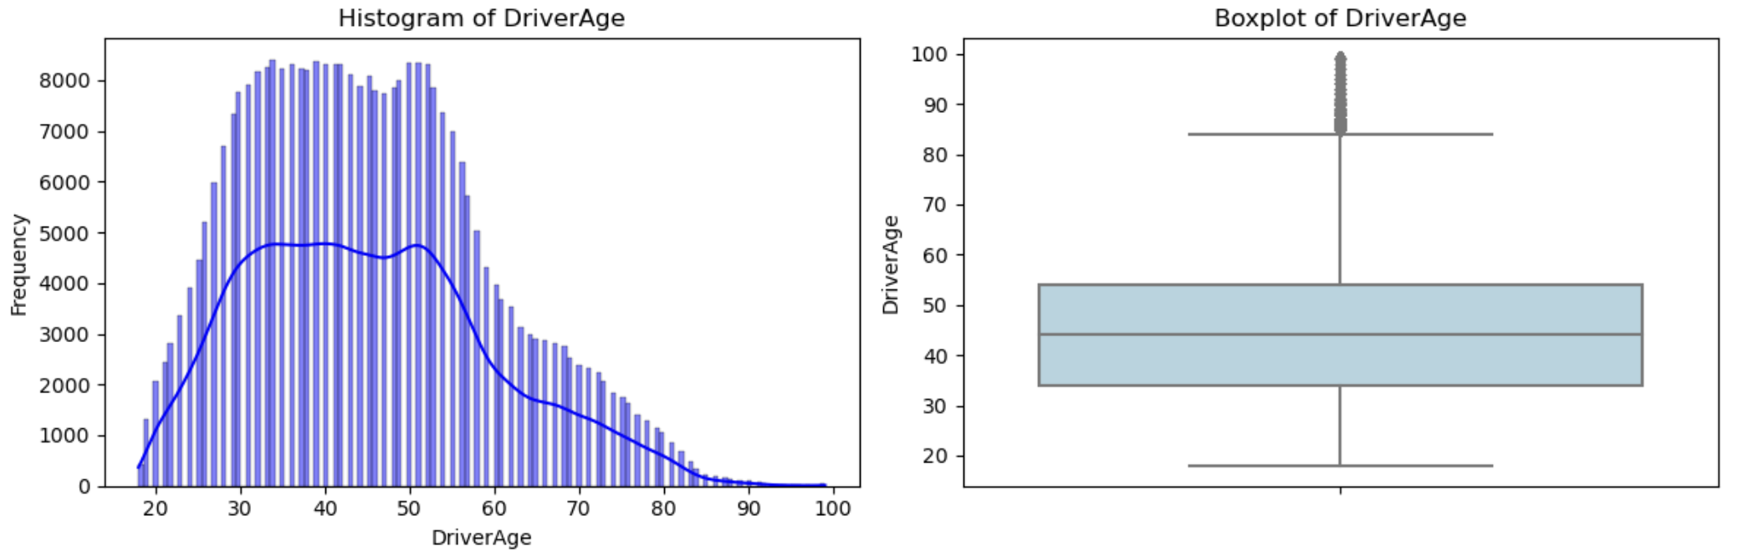
Univariate Analysis

Slide 9
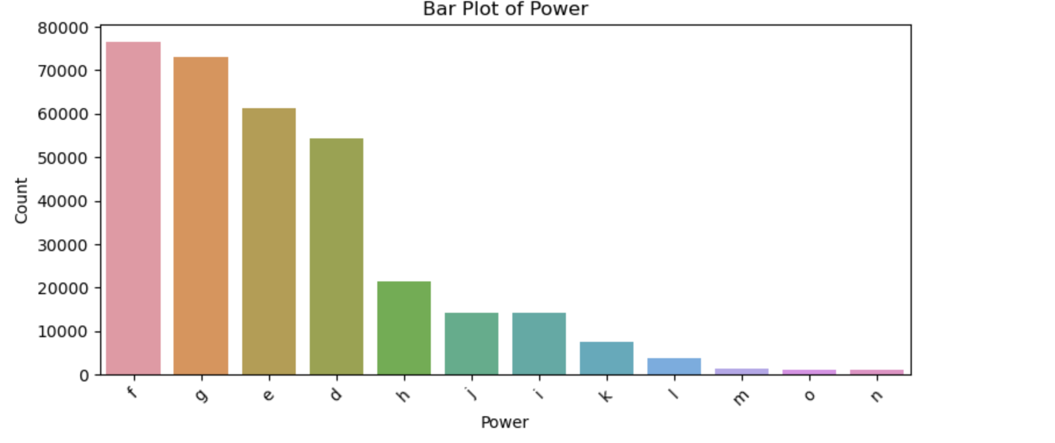
Univariate Analysis

Slide 10
Bivariate Analysis
According to the plot, there exist significant dependence between variables
In this section we aim to illustrate the bivariate plot between variables.

Slide 11
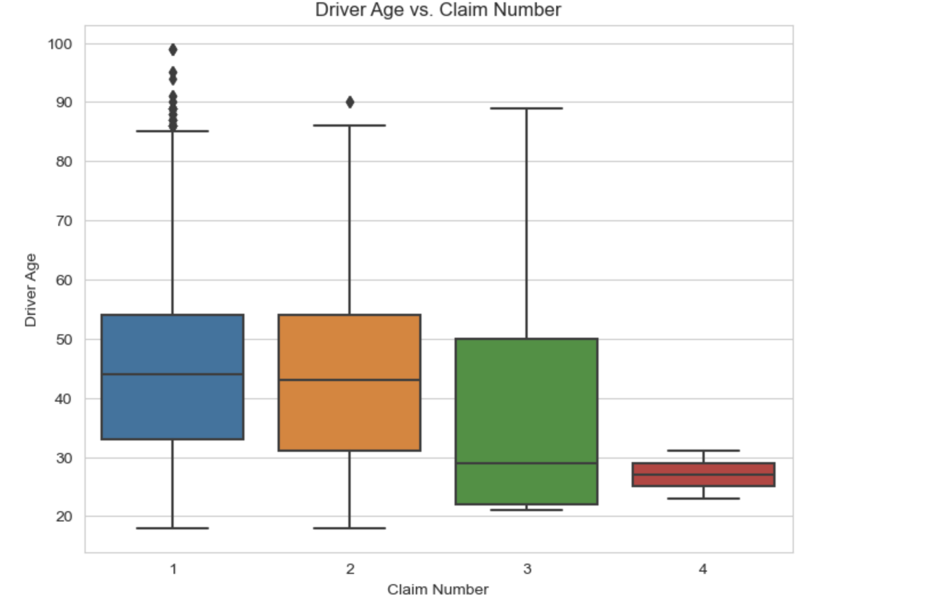
Bivariate Analysis
Driver Age VS Claim Number

Slide 12
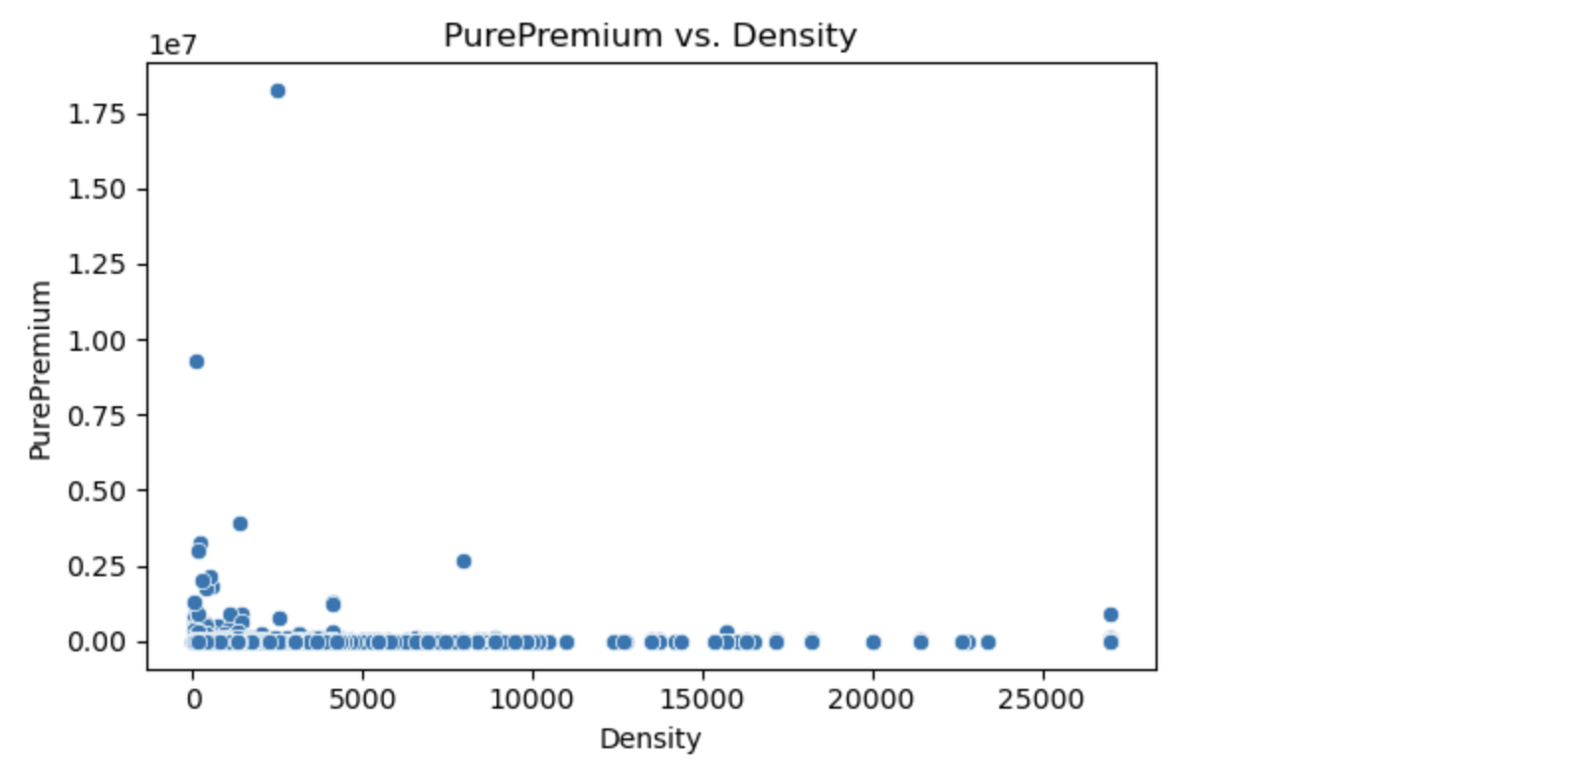
Bivariate Analysis
Pure Premium VS Density

Slide 13
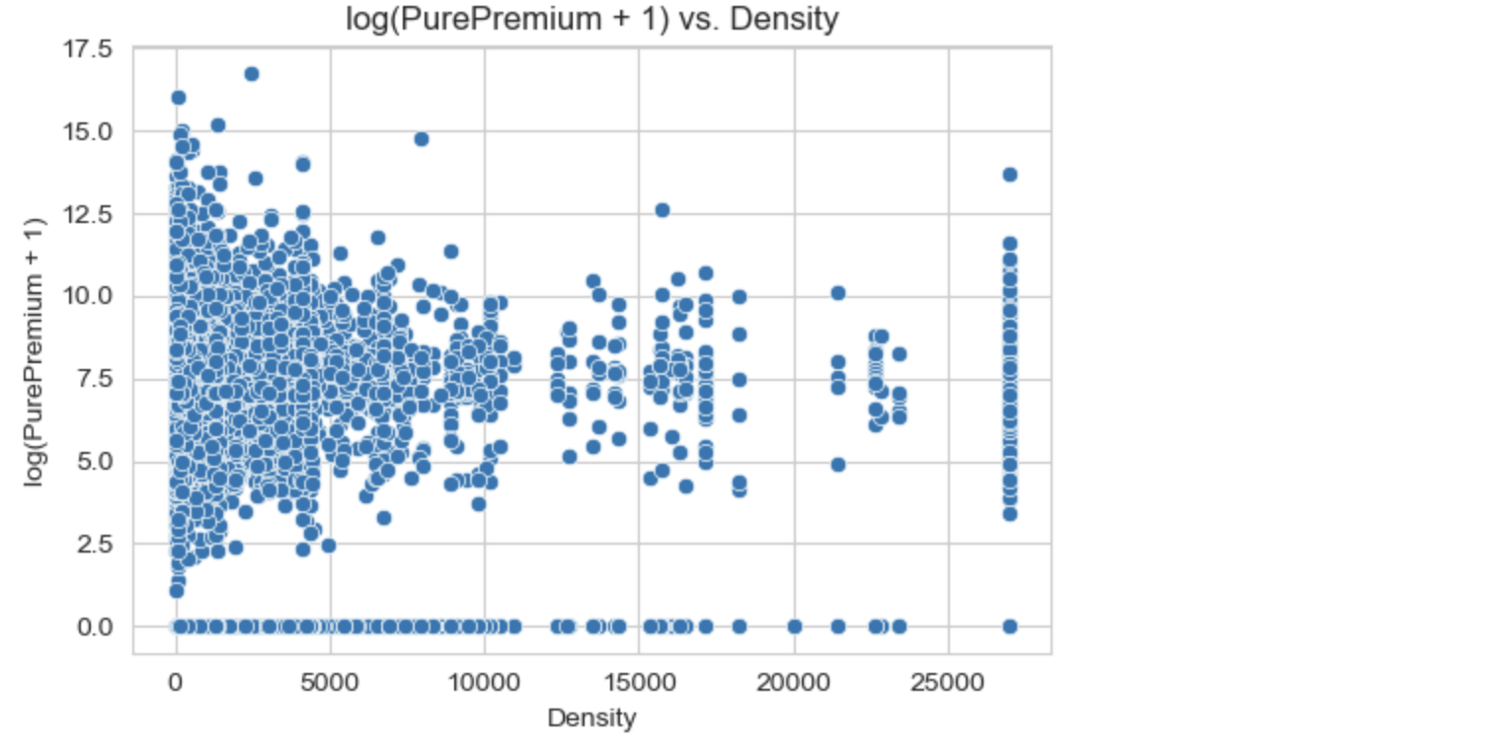
Bivariate Analysis
logged Premium VS Density

Slide 14
COMPOUND MODELING
TWEEDIE REGRESSION

Slide 15
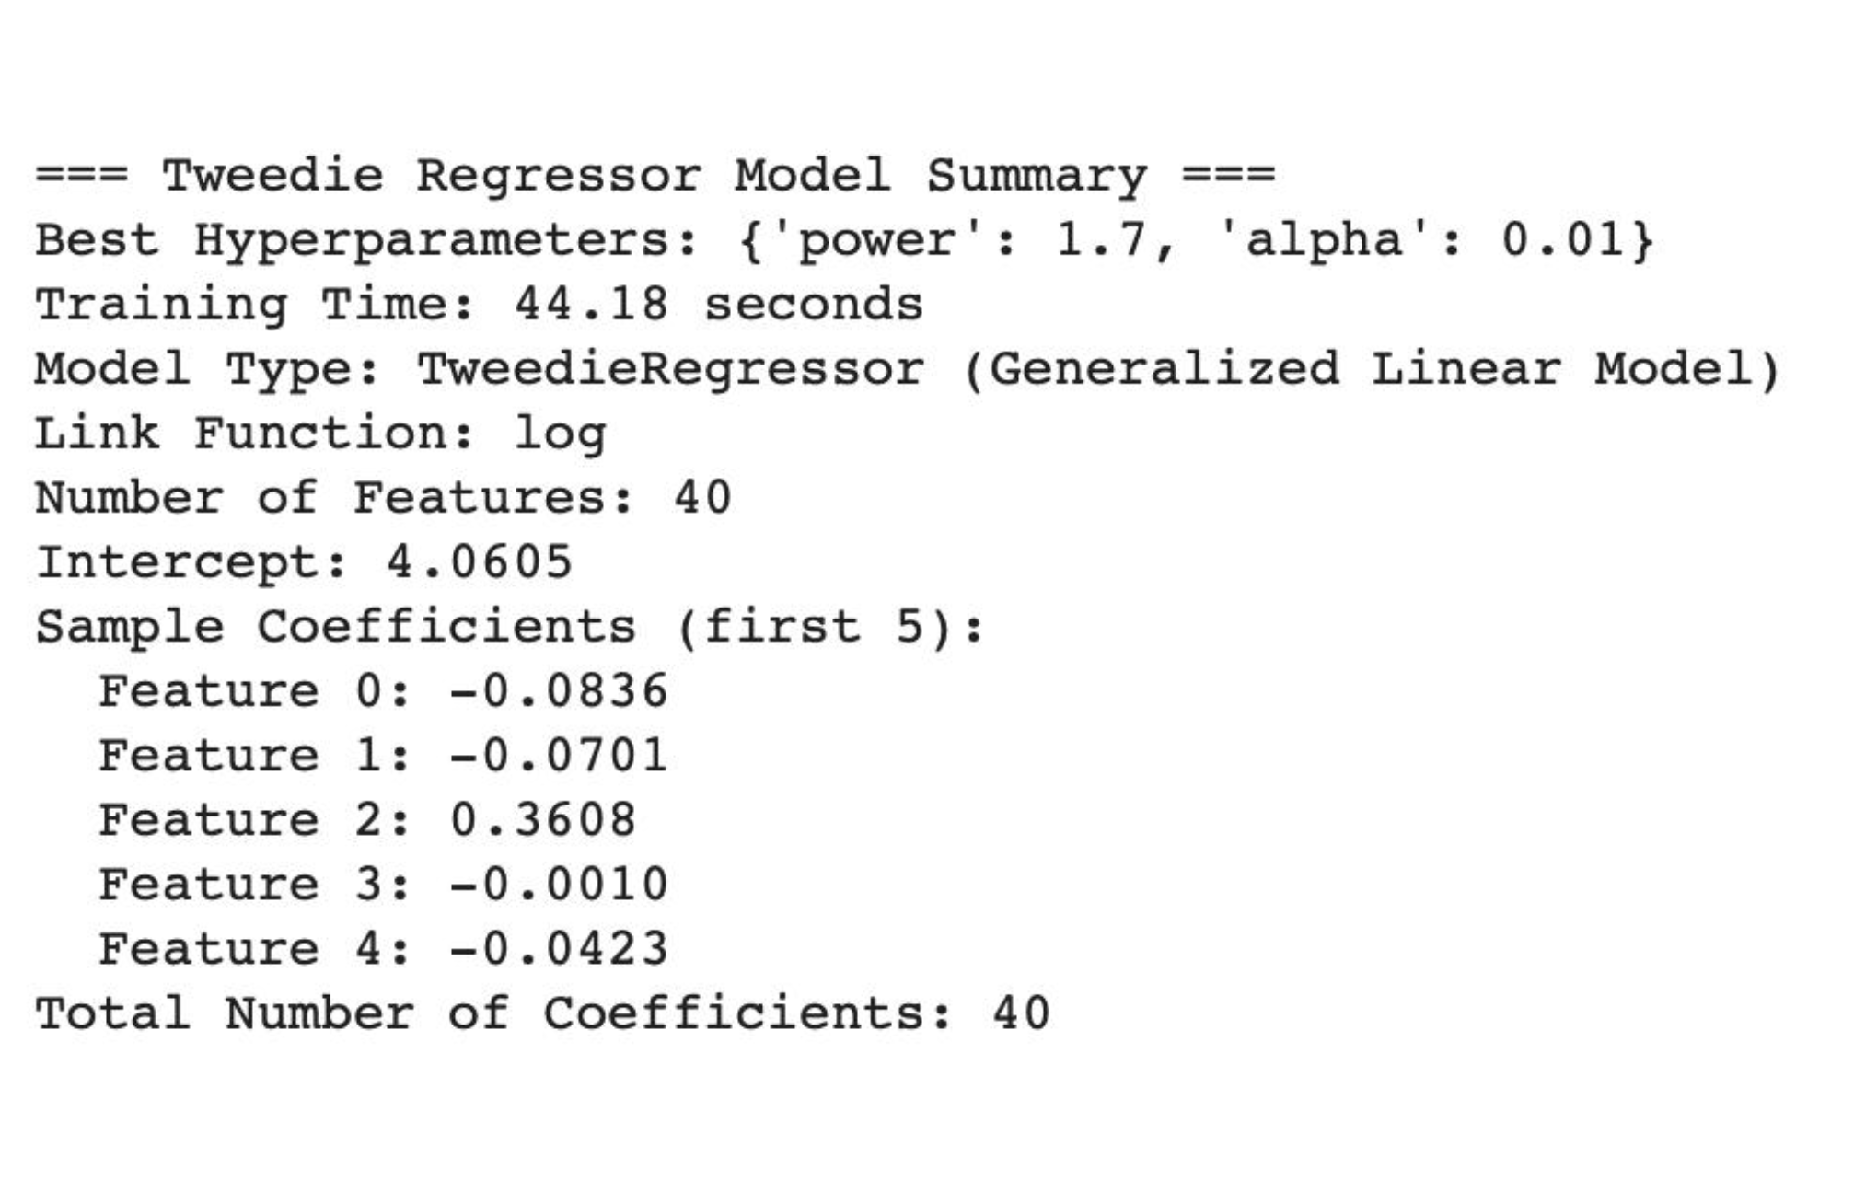
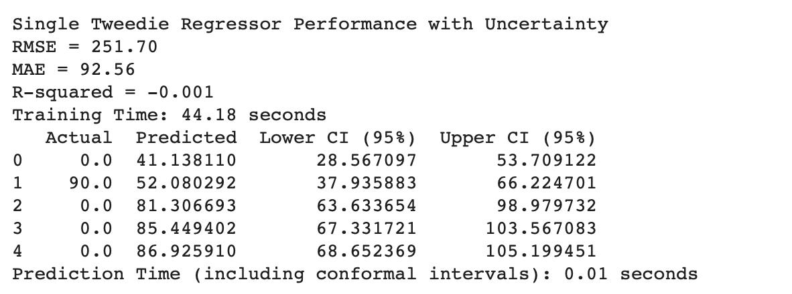
MODEL SUMMARY AND UNCERTAINITY QUANTIFICATION

Slide 16
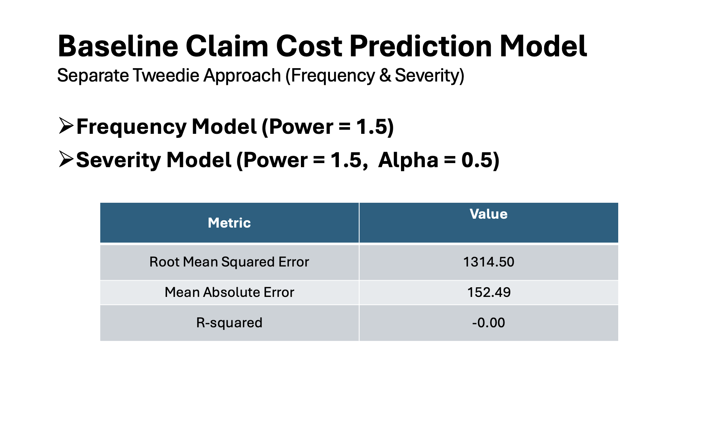
Tweedie Approach (Frequency & Severity)

Slide 17
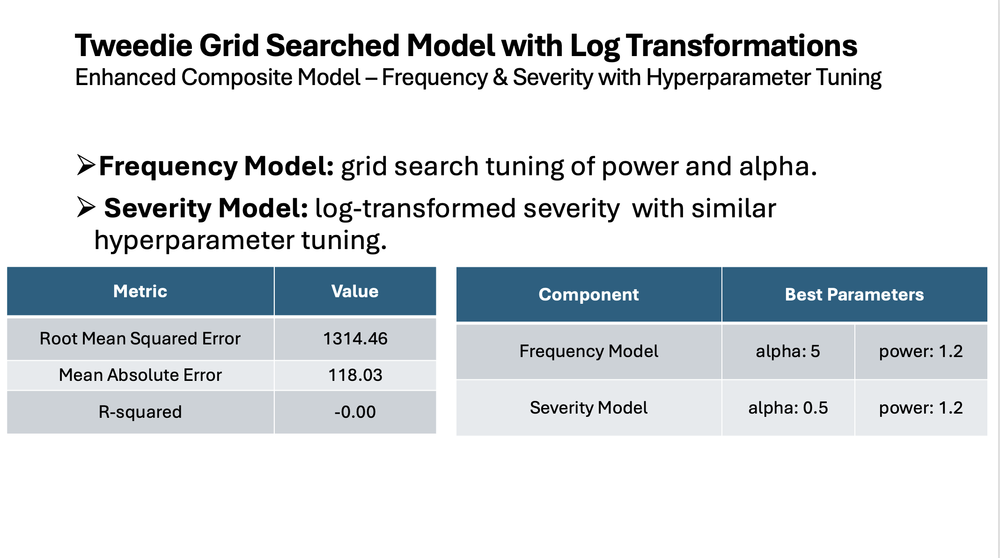

Slide 18
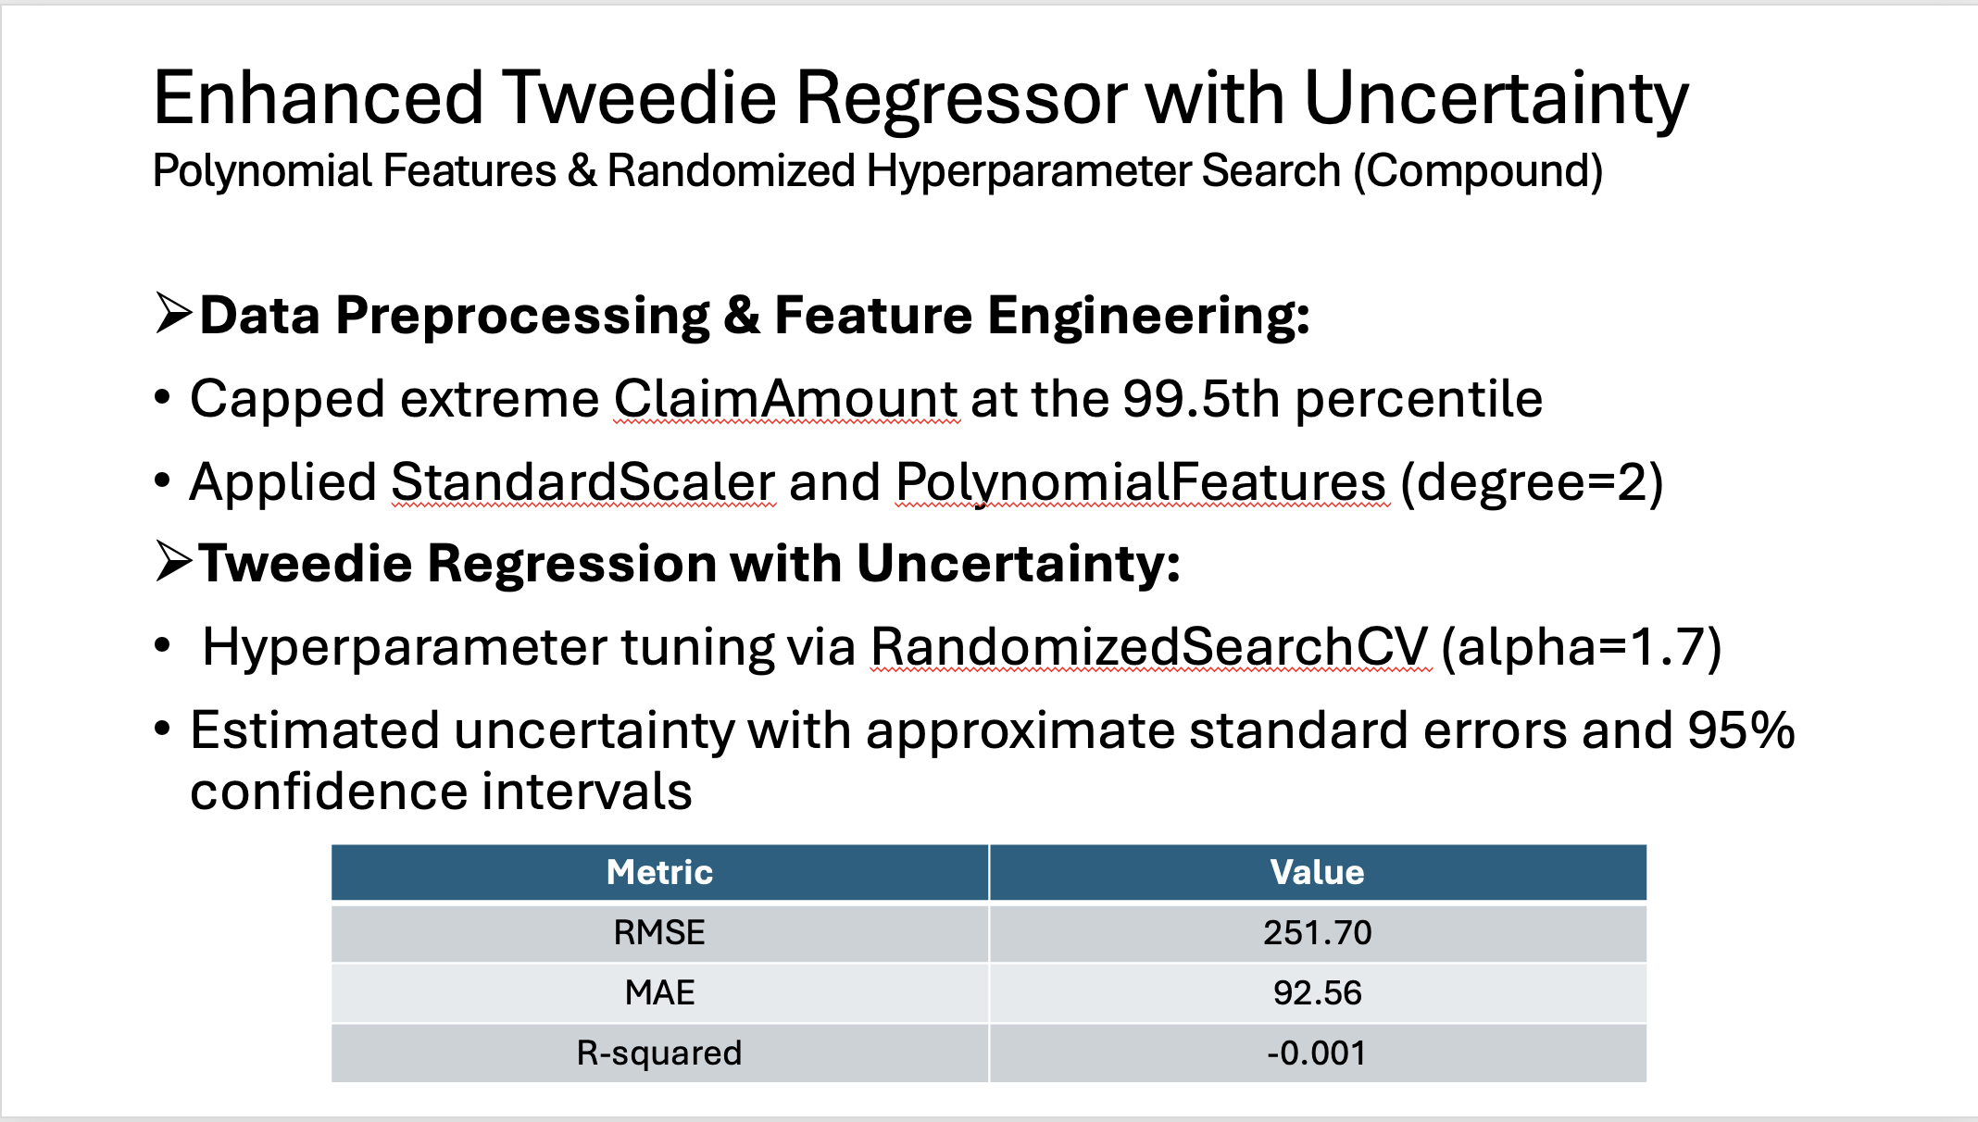

Slide 19
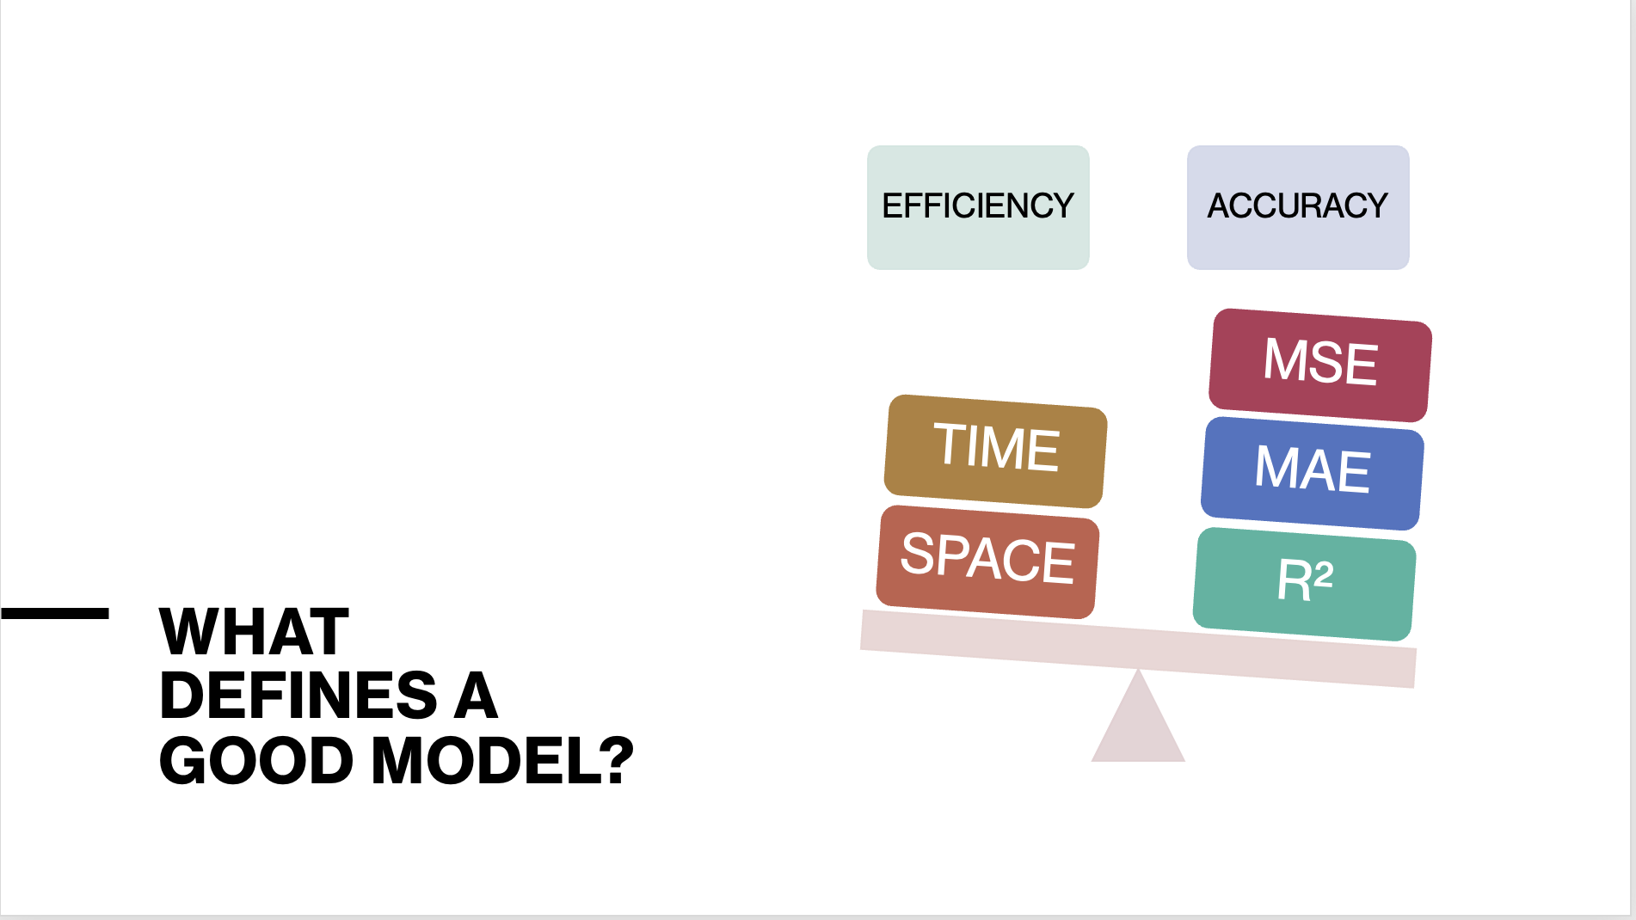

Slide 20
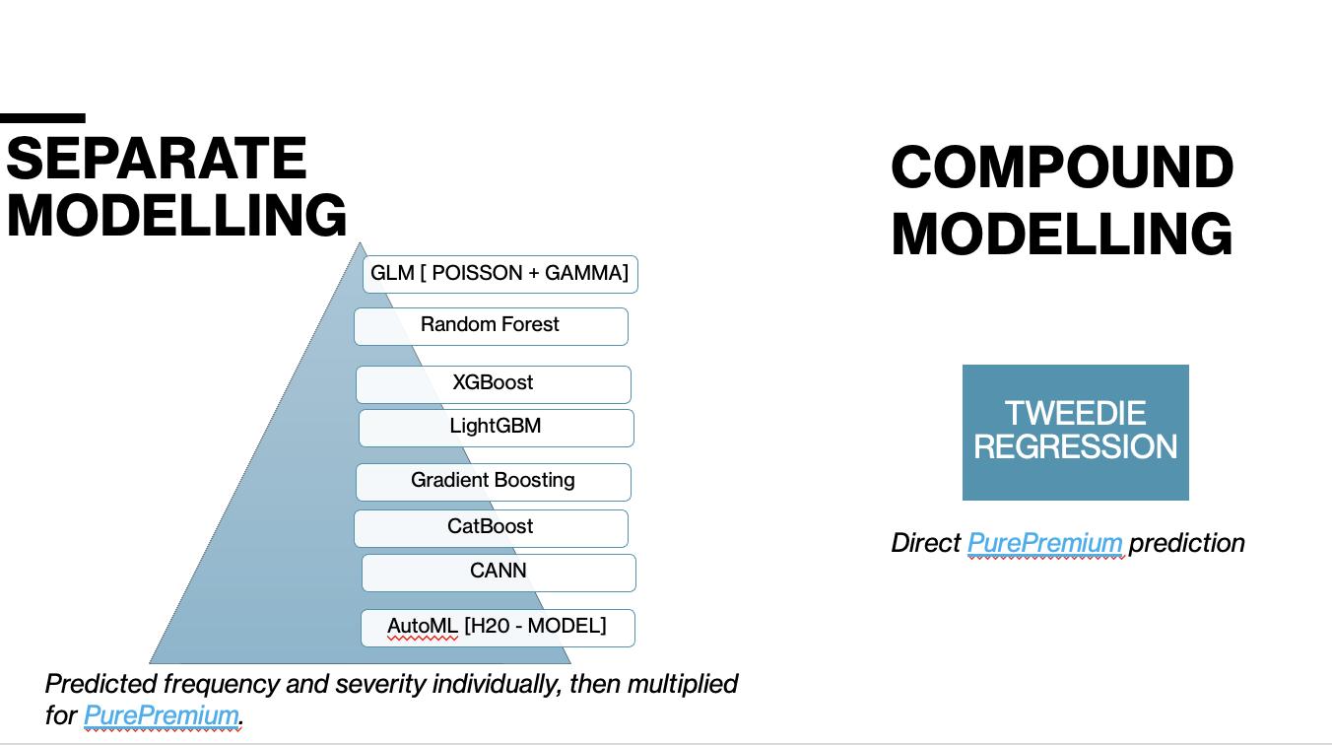

Slide 21
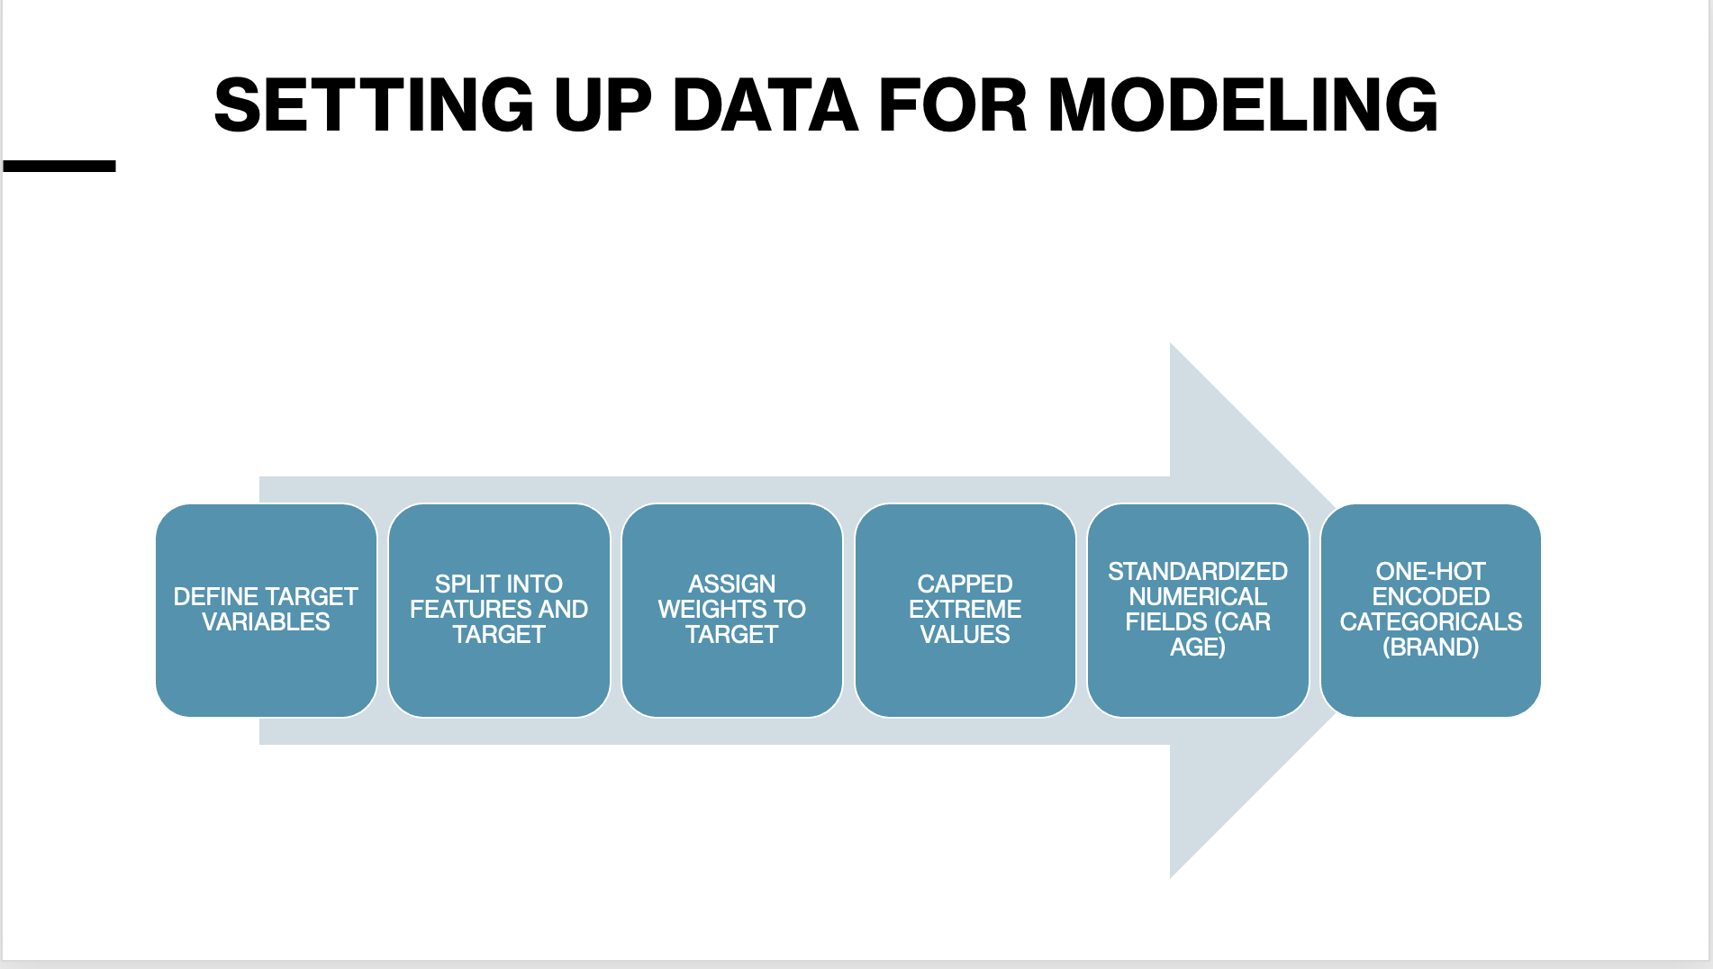

Slide 22
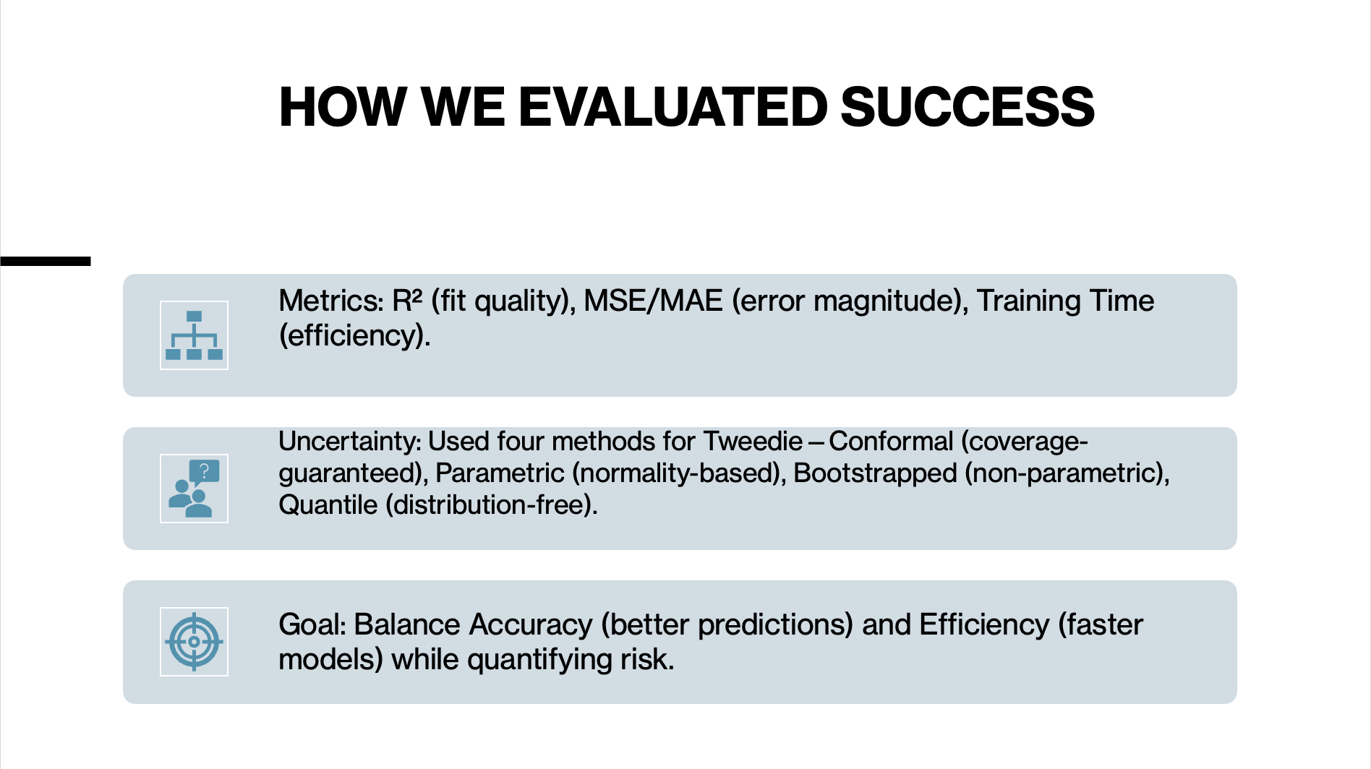

Slide 23
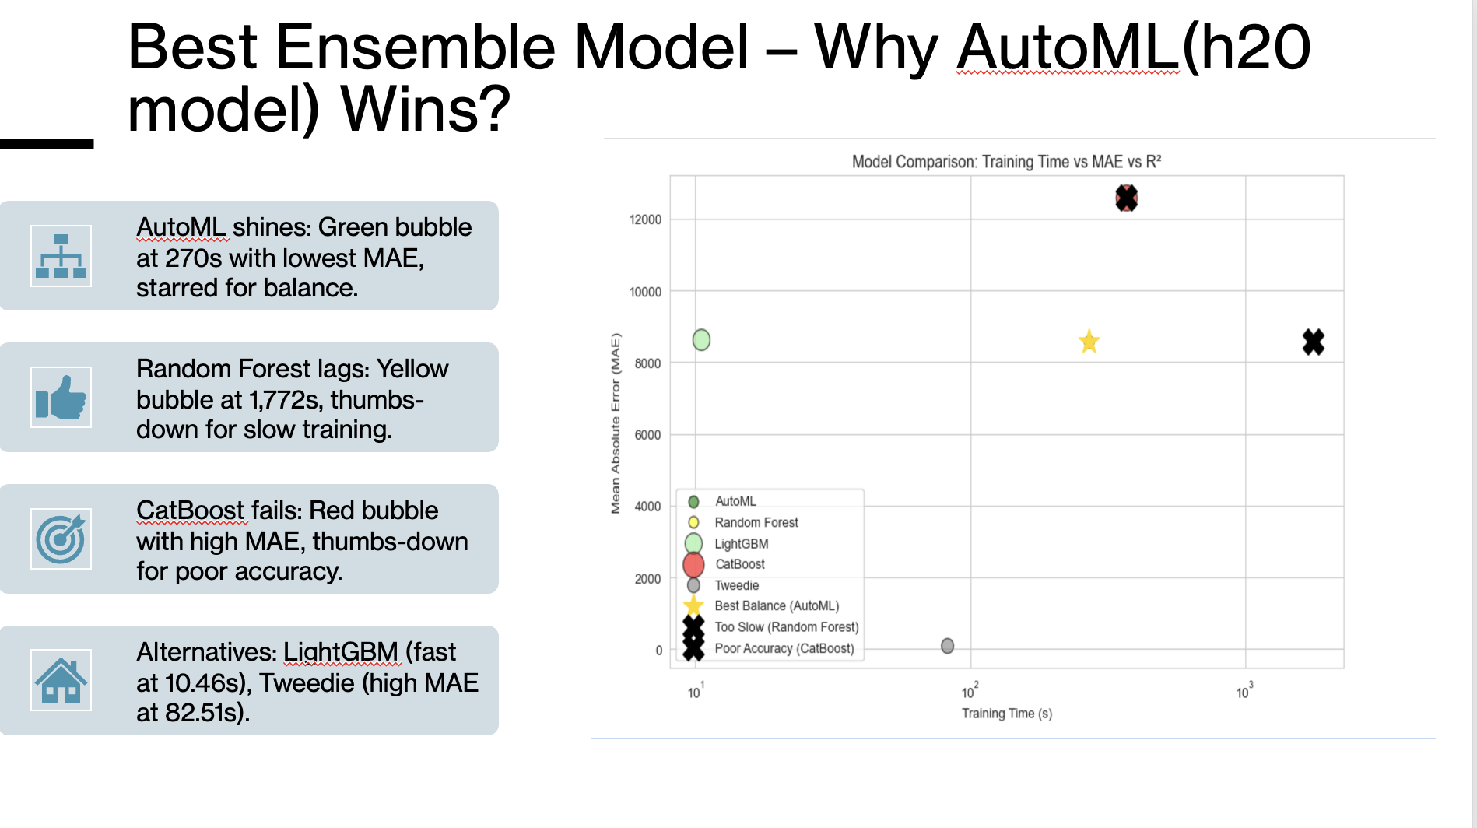

Slide 24
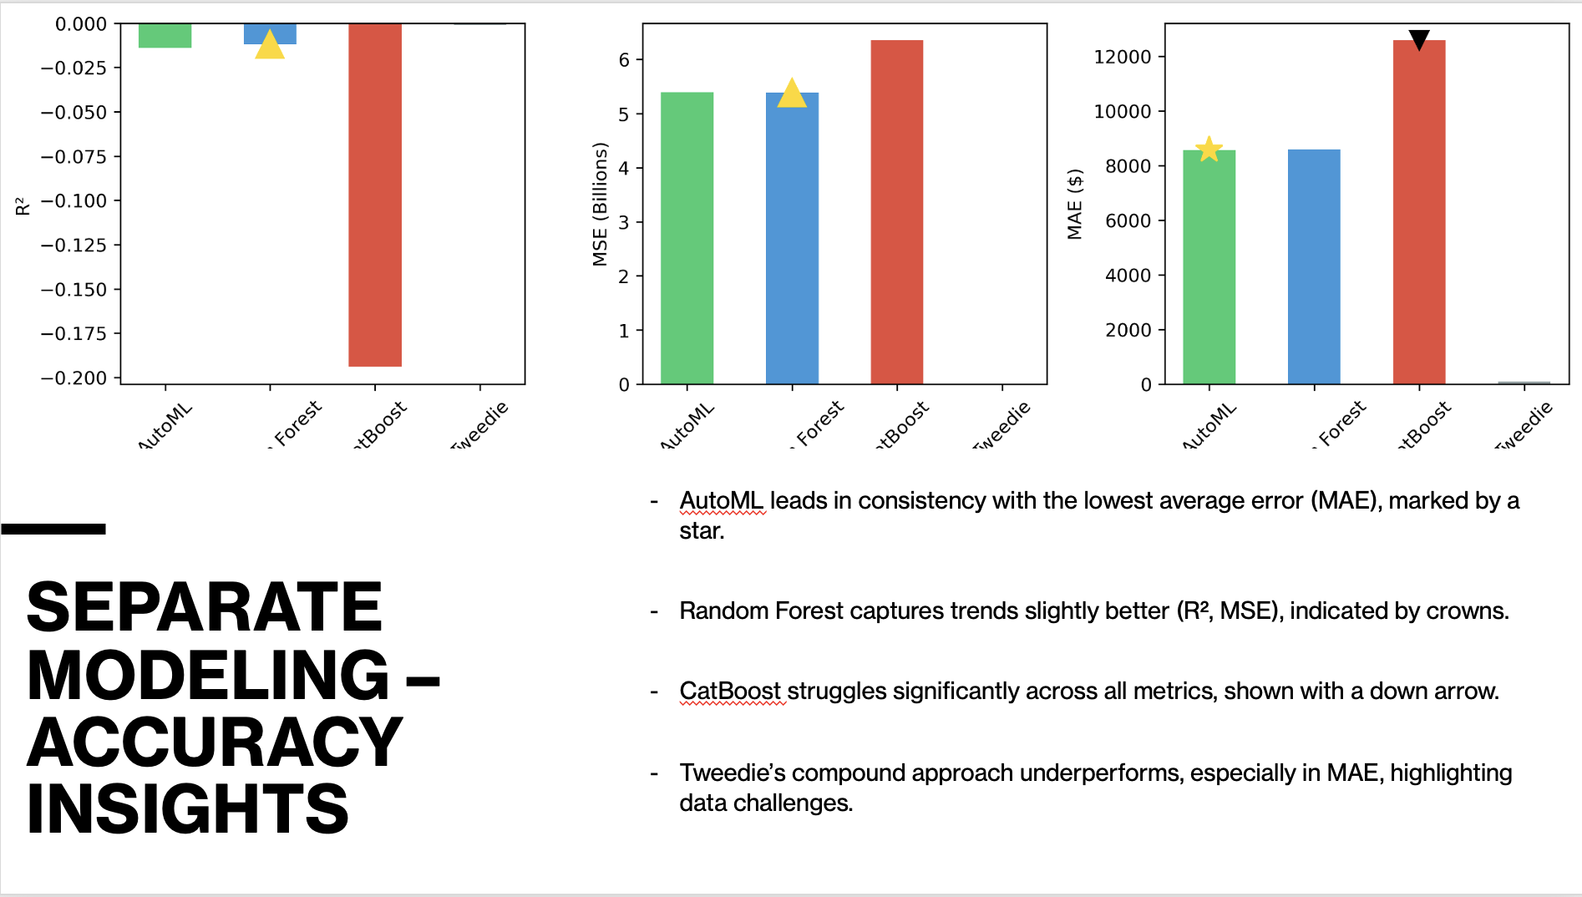

Slide 25
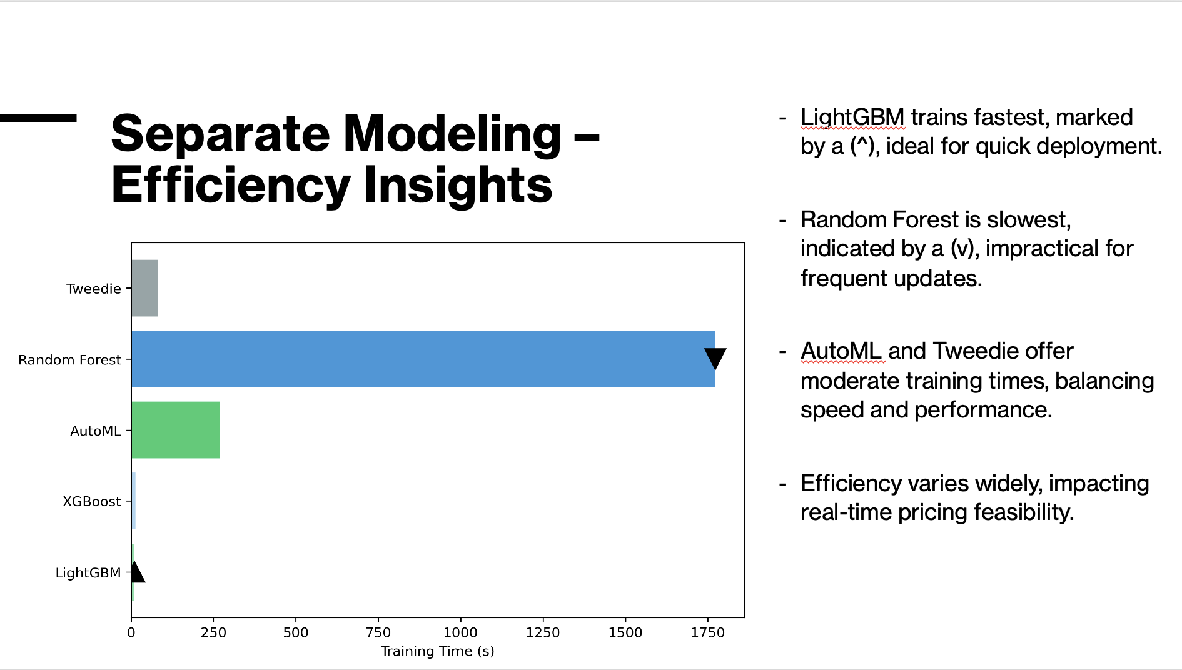

Slide 26
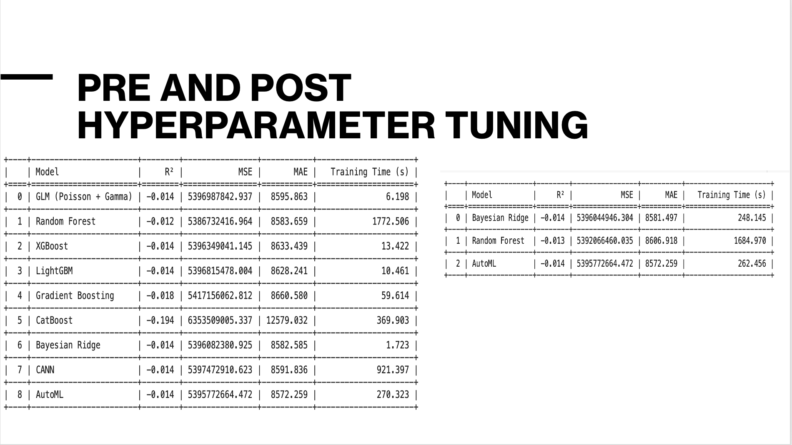

Slide 27
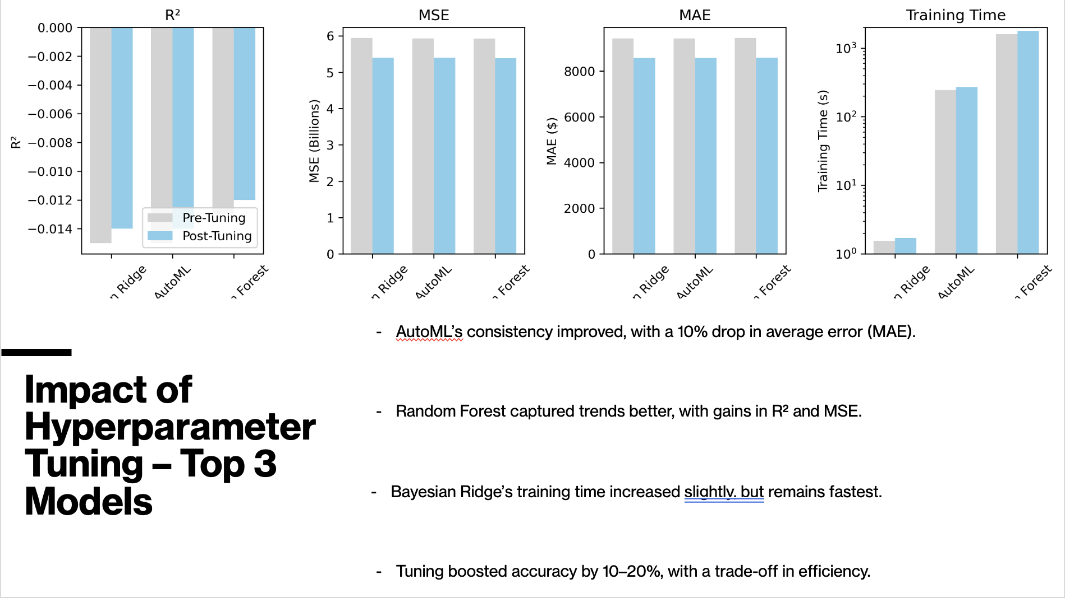

Slide 28
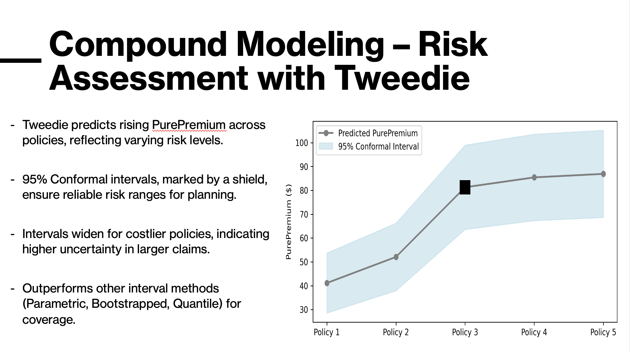

Slide 29
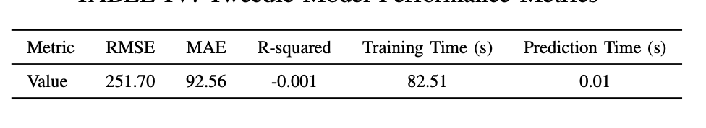
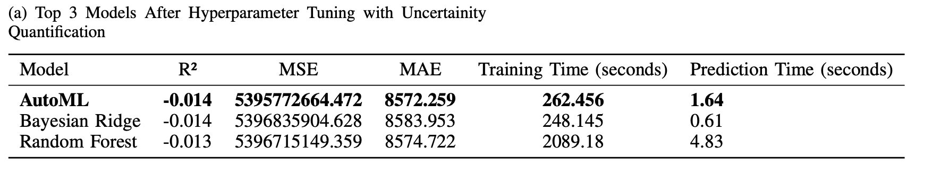
SUMMARY OF OUR FINDINGS
TWEEDIE REGRESSION WITH UNCERTAINITY QUANTIFICATION
COMPOUND MODELING (TOP 3 BEST PERFORMING) WITH UNCERTAINITY

Slide 30
THANK YOU!

